Slide 1
MASTER THESIS BY SAFIN & TEJU
Department of Computer Science,
University of Stavanger

Slide 2
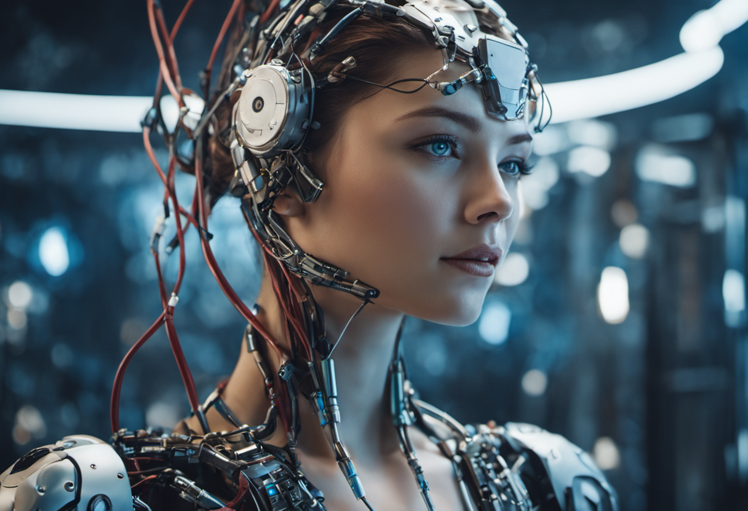
STABLE DIFFUSION AND IMAGE GENERATION WITH COMFYUI TO ASSIST DESIGNERS
CASE STUDY OF LAERDAL MEDICAL

Slide 3
PROBLEM STATEMENT
Inability to generate a fast and consistent Laerdal-style illustrations.
Inconsistent output quality
Limited customization
Difficulty in integrating AI tools into existing design
workflows.

Slide 4
goalS & OBJECTIVES
Generate consistent Laerdal-style images using Stable Diffusion.
Fine-tune with LoRA to enhance model adaptation to Laerdal’s style.
Providing illustrators and designers with better control over generated images.

Slide 5
STABLE DIFFUSION
An open- source and customizable generative model
Generates realistic and artistic images
Text – to- image model using latent diffusion

Slide 6
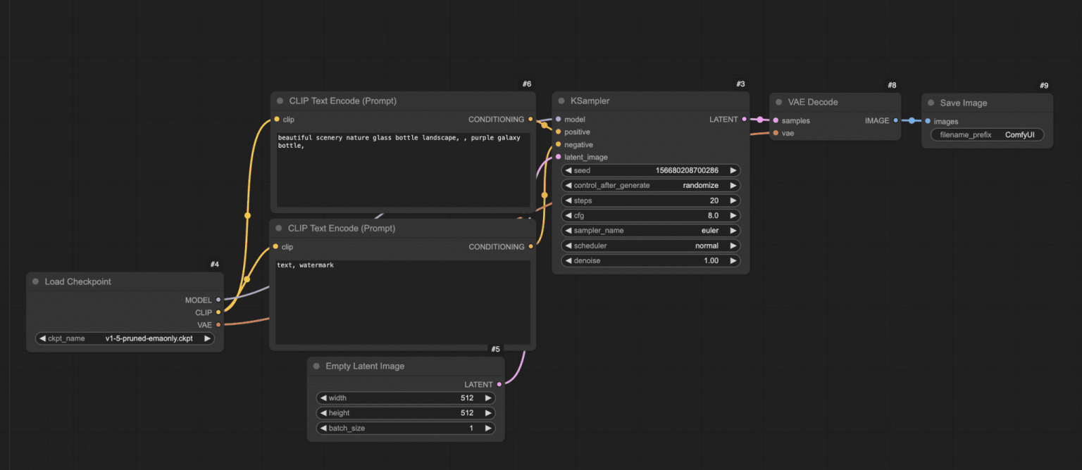
COMFYUI: VISUAL WORKFLOW INTERFACE
A node based interface for stable diffusion
Connecting nodes to define complex pipelines
Flexible user control and reproducibility

Slide 7
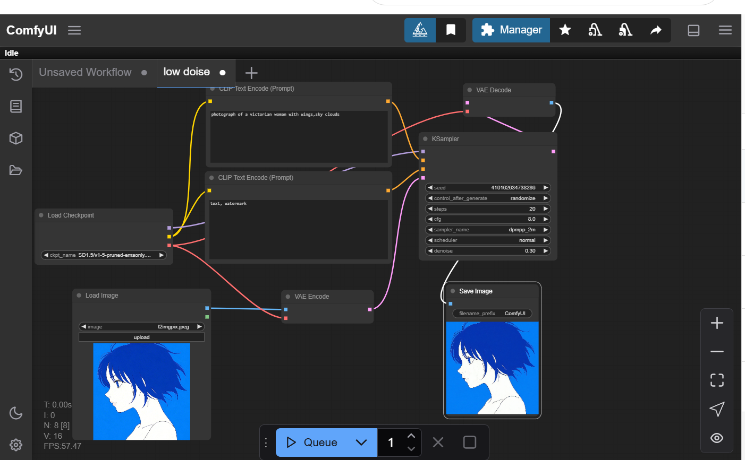
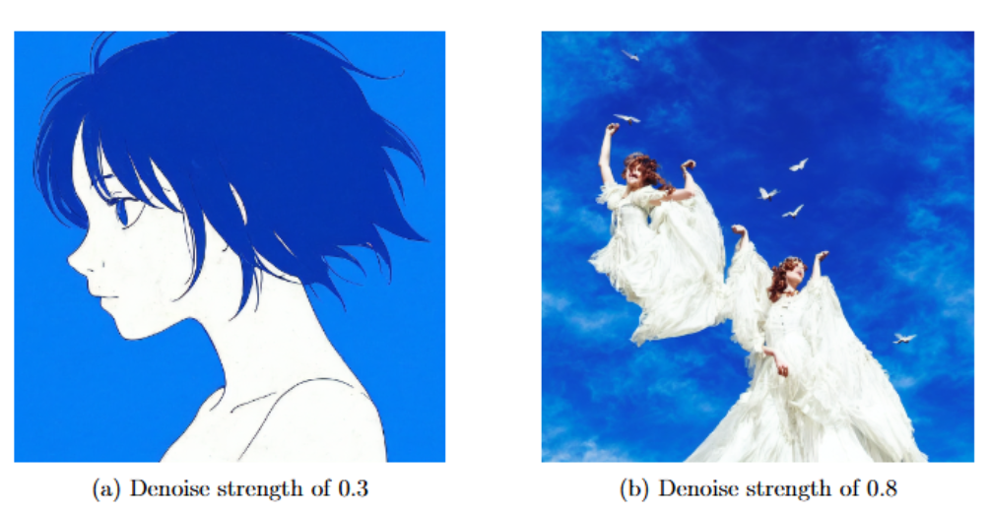
BASIC IMG2IMG WORKFLOW
Notes:
Denoising strength is the main factor! The lower the better!!

Slide 8
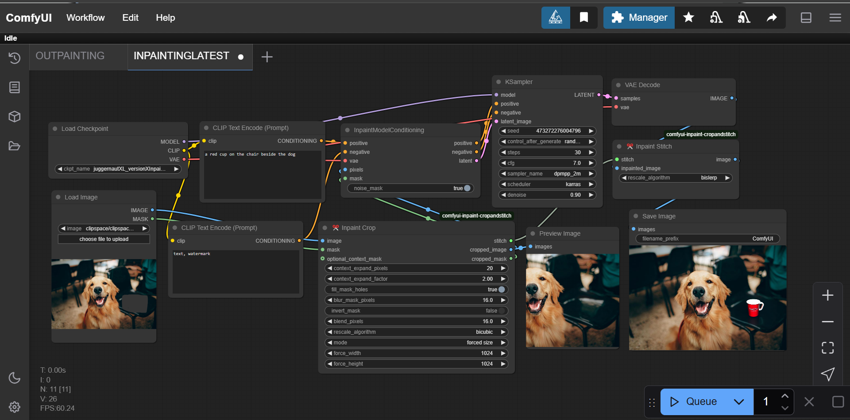
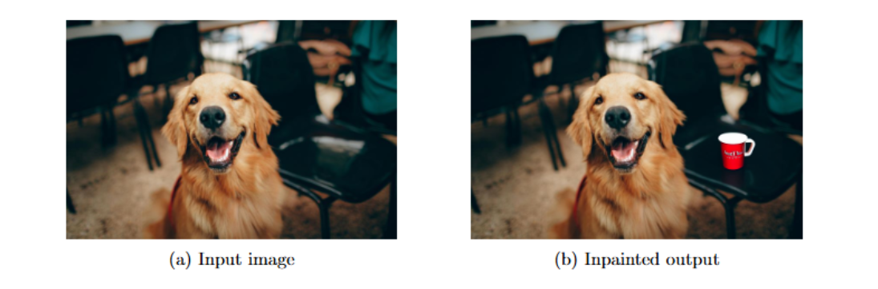
BASIC INPAINTING WORKFLOW

Slide 9
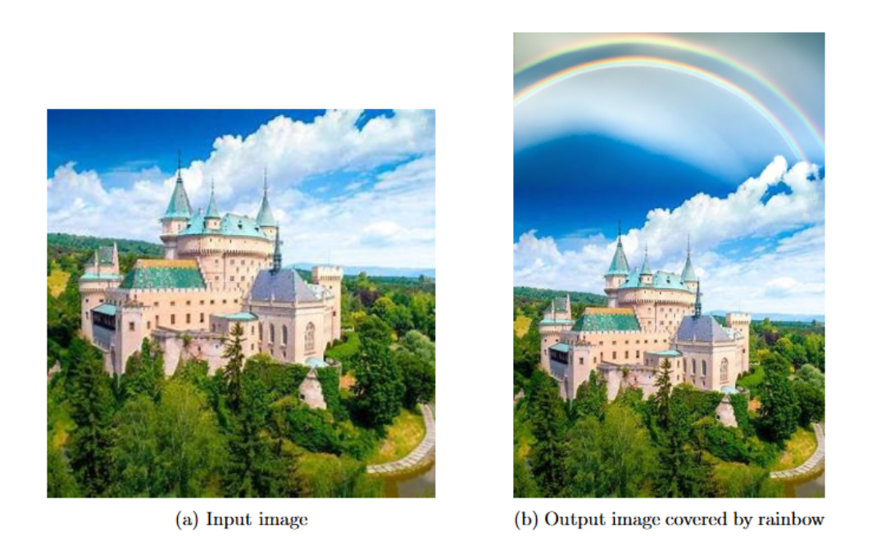
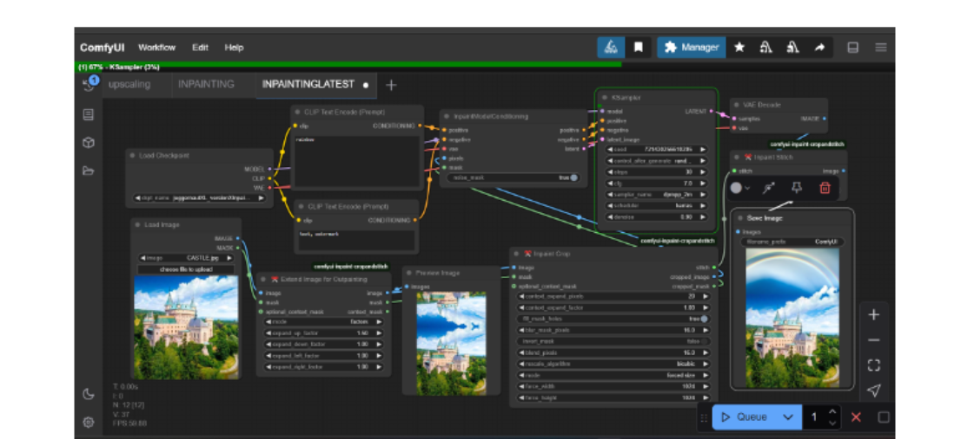
BASIC OUTPAINTING WORKFLOW

Slide 10
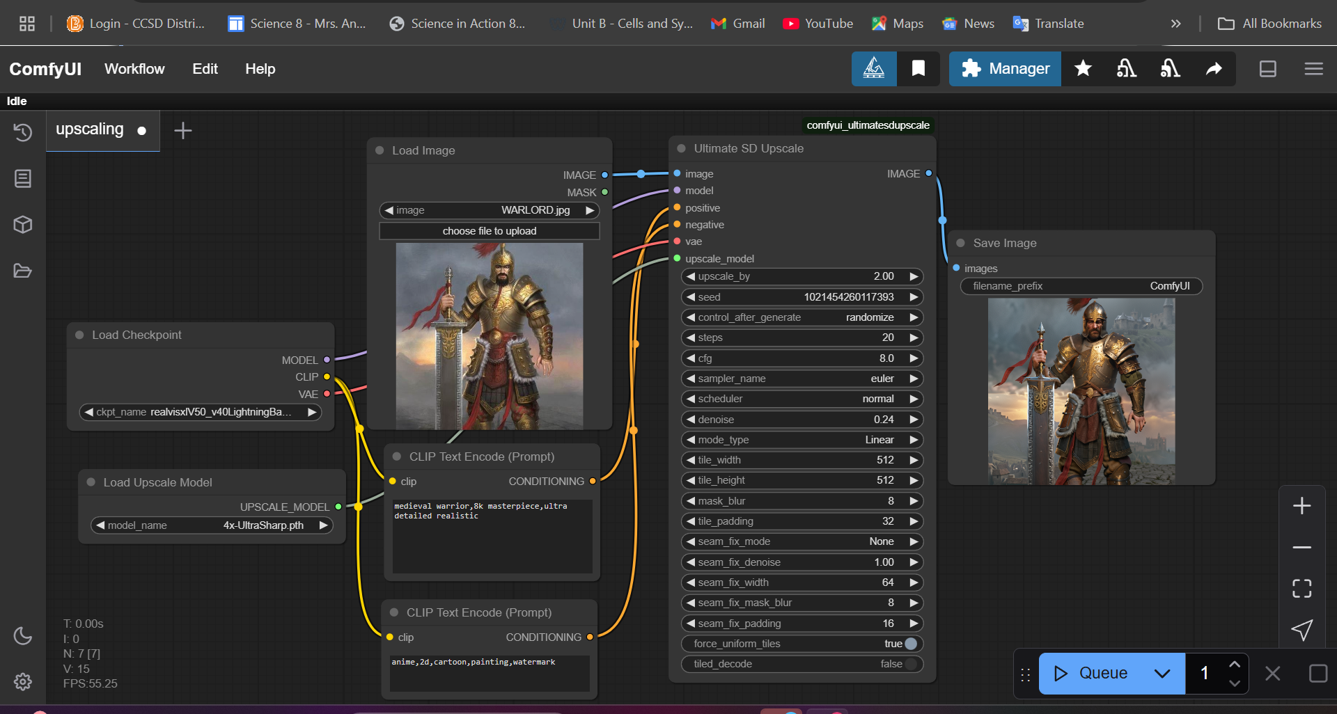
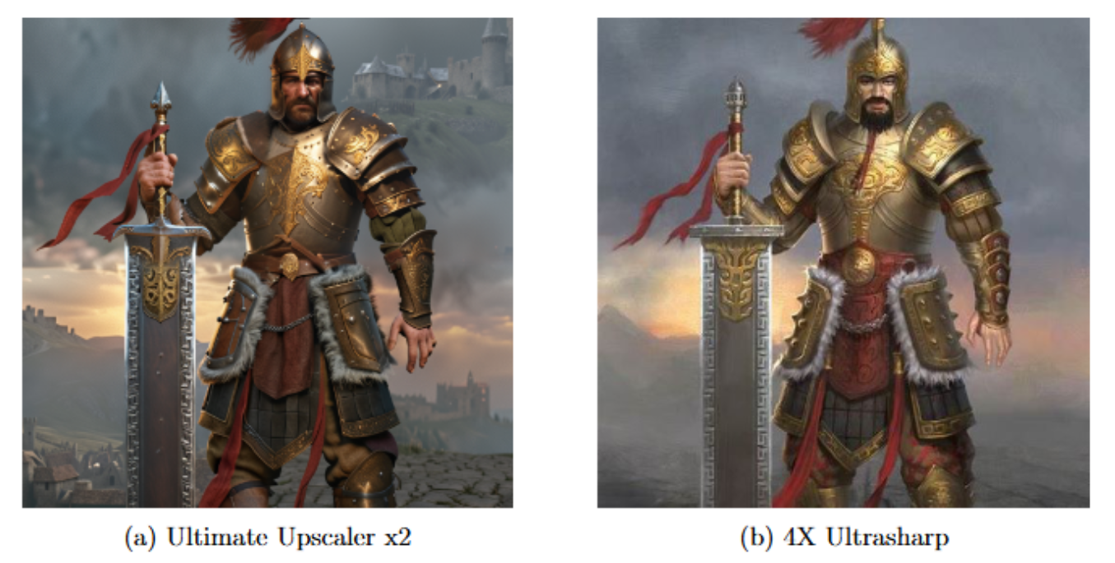
BASIC UPSCALING WORKFLOW
Notes:
More detailed output with the Ultimate Upscaler!

Slide 11
ADVANCED TECHNIQUES/TRAINING
LoRA - Low Rank Adaptation
- Efficiently fine tunes large models
- Injects minimal parameters for style learning
ControlNets
- Guides generations using pose, depth, edge maps
- Ensures structures and compositions
Kohya/Python training
-Custom LoRA fine tunning method
-Trains on custom datasets
- Enables prompt alignment.

Slide 12
Methodology
Model trained with 30 images provided by the designer
Fine tunning on base model SDv1.5
Employed Kohya and Python as tools for training the LoRA (light- weight)
ControlNet to add structure control (Pose, edge, depth maps etc)

Slide 13
MODELS COMPARISON
SD(v1.5)
SDXL
SD 3 MEDIUM
(Models can be downloaded from civitai and hugging face website)

Slide 14
PRACTICAL APPLICATIONS FOR DESIGNERS AT LAERDAL
Text2Image
Image2image
Upscaling
Image2Video

Slide 15
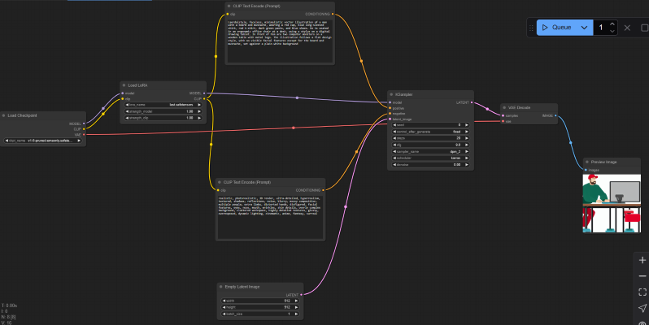
WORKFLOW EXAMPLE: text2IMG

Slide 16
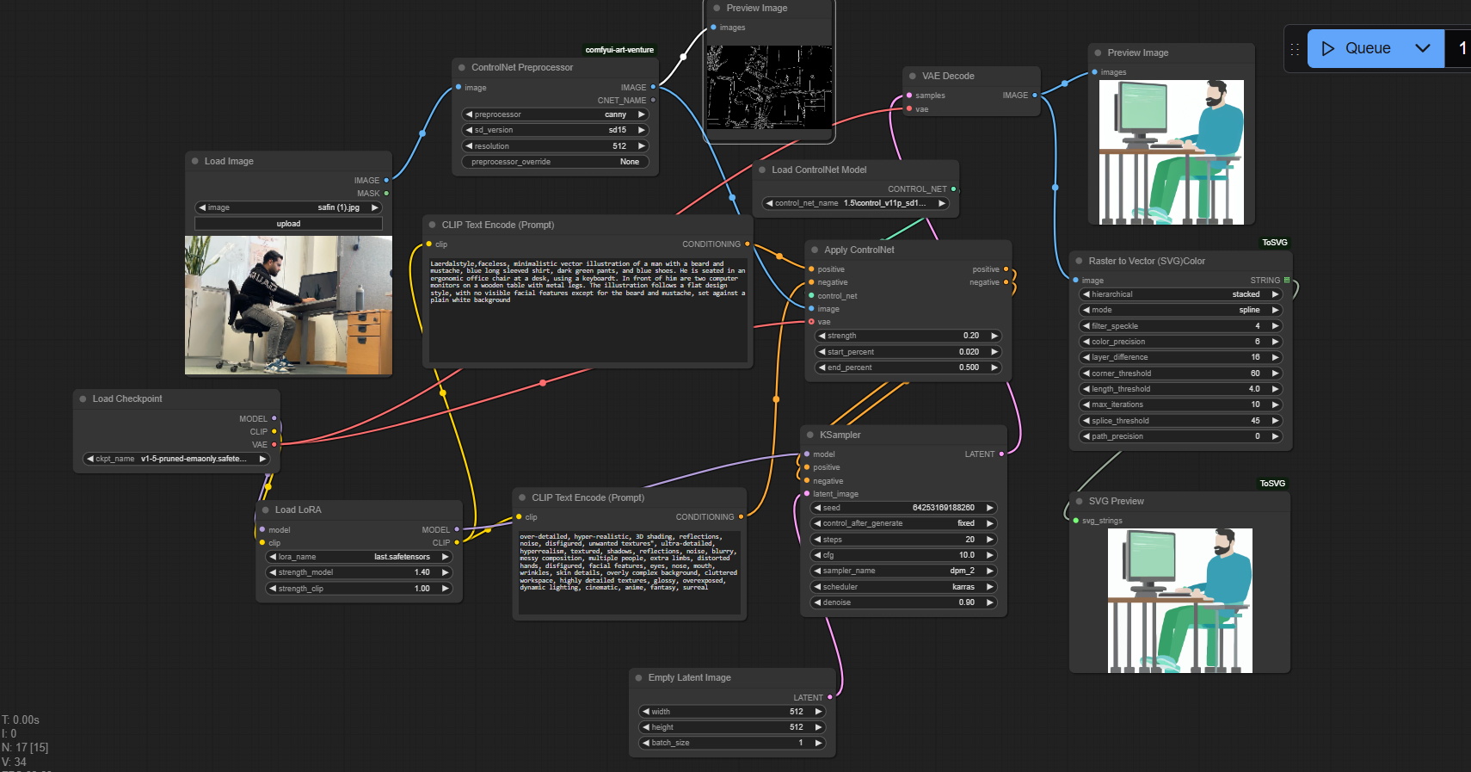
WORKFLOW EXAMPLE: IMG2IMG

Slide 17
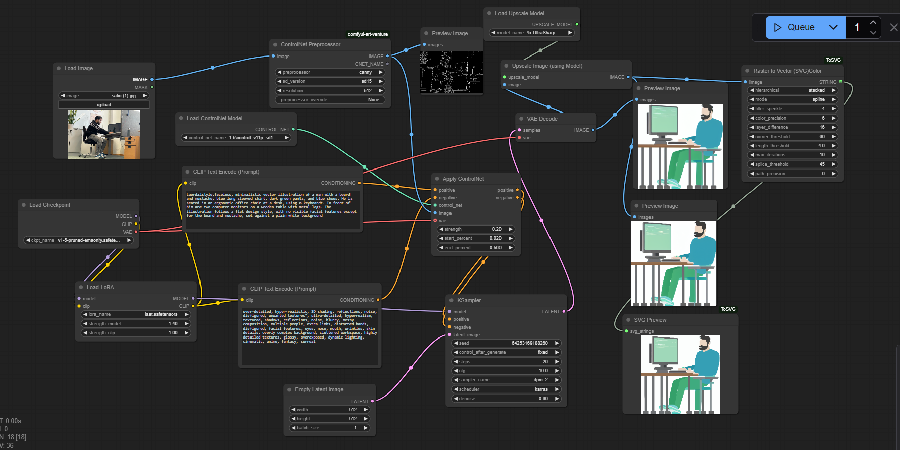
WORKFLOW EXAMPLE: UPSCALING
More detailed svg output!

Slide 18
RESULTS: CONSISTENCY & STYLE
Recreate visuals matching internal design needs
Higher consistency with base model
Style alignment achieved
Higher productivity

Slide 19
THANK YOU
We’d love to hear your thoughts, feedback and ideas for improvements!”
?

